Slide 1
PFunc: Modern Task Parallelism For Modern High Performance Computing
Prabhanjan Kambadur,
Open Systems Lab, Indiana University
With Anshul Gupta (IBM), Amol Ghoting (IBM), Haim Avron (Univ. of Tel Aviv), and Andrew Lumsdaine (IU)

Slide 2
Overview
Motivation
PFunc
Library-based solution for task parallelism
Case studies
Conclusion
Notes:
1) OpenMP community has also realized that task groups are needed. Mentioned in yesterday’s BOF.
2) Fibonacci numbers program shown here is not the end all and be all of this program. It is merely used to demonstrate task creation overheads
Introduction to the talk. Moore’s law is not giving us faster processors. What we have instead are more cores – meaning that mainstream applications need to be parallelized to increase their performance. Existing parallel models are driven by previous generation hardware and applications (traditional HPC).
Review of classic task-based parallelism and discuss PFunc’s features using example of fibonacci

Slide 3
Parallelization enters the mainstream
Parallelize a wide variety of applications
Traditional HPC, informatics, mainstream
Parallelize for modern architectures
Multi-core, many-core and GPGPUs
Enable user-driven optimizations
Fine tune application performance
No runtime penalty
Notes:
OpenMP community is trying to add something to its tasking model so that there is some locality
Informatics data sets have large and dynamic datasets that are both accessed irregularly and cannot be partitioned apriori. So, they are extremely sensitive to load balancing and scheduling.

Slide 4
Task parallelism and Cilk
Program broken down into smaller tasks
Independent tasks are executed in parallel
Generic model of parallelism
Subsumes data parallelism and SPMD parallelism
Cilk is the best-known implementation
Leiserson et al
C and C++, shared memory
Introduced the work-stealing scheduler
Guaranteed bounds on space and time
But…
Notes:
There is a distributed version of Cilk at some point – but mostly its for shared memory.
But... these were also developed for previous generation applications and previous generation hardware!

Slide 5
Cilk-style parallelization
Order of discovery
1 Thread
Order of completion
11
n
1
5
n-1
n-2
2
10
7
3
n-2
n-3
n-3
n-4
3
6
4
8
6
9
9
1
n-3
n-4
n-5
n-6
11
4
5
10
8
2
7
Depth-first discovery, post-order finish
Notes:
In theory, the DFS execution is slightly altered because of the fact that all the children of a node are put on the queue and then other empty threads are given a chance to actually steal work from them. Note that this is not how its depicted here in this picture. Mention data locality being exploited between parents and siblings.

Slide 6
Cilk-style parallelization
Thread-local Deques
n
Thd 1 | Thd 2
n
Thd 1 | Thd 2
n-3 | n-4
n | n-2
 | n-1
Thd 1 | Thd 2
n | n-4
 | n-3
 | n-2
 | n-1
Thd 1 | Thd 2
n-2
n-1
n
Thd 1 | Thd 2
n-2 | n-1
n
n-1
n-2
1. Breadth-first theft.
2. Steal one task at a time.
3. Stealing is expensive.
n-2
n-3
n-3
n-4
n-3
n-4
n-5
n-6
Steal (n-1)
Steal (n-3)
Notes:
What is labeled is the order of completion
The table shows the tasks in the queue. A will complete last, but is taken off the queue regardless.
The last steal is quite expensive as it is lower down in the tree.

Slide 7
Drawbacks of Cilk-style parallelism
Scheduling policy is hard-coded
Tasks cannot have priorities
Difficult to switch task scheduling policy
Must use divide and conquer
Cannot exploit data locality between tasks otherwise
Fully strict computation model
Task graph is always a tree
Cannot directly execute general DAG structures
Cannot mix SPMD and task parallelism
Notes:
1. Mention that algorithms have to be refactored into divide and conquer. Many algorithms are naturally expressed in other forms!

Slide 8
PFunc: An overview
Library-based solution for task parallelism
C and C++ APIs, shared memory
Extends existing task parallel feature set
Cilk, Threading Building Blocks (TBB), Fortran M, etc
Fully customizable
Generic and generative programming principles
No runtime penalty for customizations
Tasks do not require virtual function calls
Portable
Linux, OS X and AIX
Windows release soon!
Notes:
OpenMP, Tascell, Tpascal, MulTScheme left out on purpose.
Idea here is to identify the core features of task parallelism and lift it – like any good generic programmer!

Slide 9
PFunc: Feature set
Feature | Explanation
Scheduling Policy | Determines task scheduling (eg., cilkS, prioS)
Compare | Ordering function for the tasks (e.g., std::less<int>)
Functor | Type of the function to be parallelized
struct fibonacci;
typedef pfunc::generator <cilkS, // Scheduling policy
pfunc::use_default, // Compare
fibonacci> // Functor
my_pfunc;

Slide 10
PFunc: Nested types
Type | Explanation
attribute | Attached to each task. Used for affinity, priority, etc
group | Attached to each task. Used for SPMD-style programming
task | Handle to a spawned task. Used for status checks
taskmgr | Represents PFunc’s runtime. Encapsulates threads and queues
typedef my_pfunc::attribute my_attr;
typedef my_pfunc::group my_group;
typedef my_pfunc::task my_task;
typedef my_pfunc::taskmgr my_taskmgr;

Slide 11
Fibonacci numbers
my_taskmgr gbl_taskmgr (N /*num queues*/, M /*thds per queue*/);
struct fibonacci {
fibonacci (const int& n) : n(n), answer(0) {}
void operator () (void) {
if (0 == n || 1 == n) answer = n;
else {
task tsk;
fibonacci fib_n_1 (n−1), fib_n_2 (n−2);
pfunc::spawn (∗gbl_taskmgr, tsk, fib_n_1);
fib_n_2();
pfunc::wait (∗gbl_taskmgr, tsk);
answer = fib_n_1.answer + fib_n_2.answer;
}
}
int answer;
const int n;
};
Notes:
Talk about how this is similar to Cilk in that it allows one task to be executed serially and another to be launched in parallel. TBB cannot do this.
We can get anywhere from work-stealing to thread pooling model.

Slide 12
PFunc: Fibonacci performance
Threads | Cilk (secs) | PFunc/Cilk | PFunc/TBB
1 | 2.17 | 2.2178 | 0.5004
2 | 1.15 | 2.1135 | 0.5041
4 | 0.55 | 2.2131 | 0.5009
8 | 0.28 | 2.2114 | 0.4437
16 | 0.15 | 2.4944 | 0.4201
2× faster than TBB
2× slower than Cilk
Provides more flexibility than TBB or Cilk
* Quad-socket quad-core AMD 8356, GCC 4.3.2, Cilk 5.4.6, TBB 2.1, Linux 2.6.24

Slide 13
PFunc’s enhancements
Customizable task scheduling and task priorities
cilkS, prioS, fifoS, and lifoS provided
Multiple task completion notifications on demand
Deviates from the strict computation model
Task groups
SPMD-style parallelization
Task affinities
Heterogeneous architectures
Attach tasks to queues and queues to processors
Exception handling and profiling

Slide 14
Case Studies

Slide 15
Demand-driven DAG execution
Data-driven DAG execution has many shortcomings
Increased memory consumption in many applications
Over-parallelization (e.g., Sparse Cholesky Factorization)
Strict computation model precludes
Demand-driven execution of general DAGs
Only supports execution of trees
PFunc supports demand-driven DAG execution
Multiple task completion notifications
Task priorities to control execution
Notes:
By over parallelization, I mean to say that we are unnecessarily launching jobs even though there is no more computing power – might as well execute the the sub-DAGs sequentially.

Slide 16
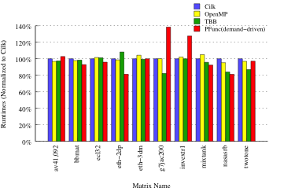
DAG execution: Runtime
Notes:
The DAGs were generated in the symbolic phase of the sparse unsymetric multifrontal cholesky solver. Two pieces of information are given to us – the structure and the weight. With the weight, we can calculate both the memory requirements and the computational structure (weight) of each node. The only difference is that in the real problem, the calculated LU is not always evenly distributed to the children. So the memory access patterns might be slightly different from the original. However, takes too much time to implement an actual solver.
SunCC 5.10

Slide 17
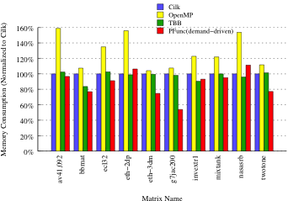
DAG execution: Peak memory usage

Slide 18
Frequent pattern mining (FPM)
FPM algorithms are not always recursive
The best known algorithm (Apriori) is breadth-first
Optimal execution depends on locality between tasks
Current solutions do not support task affinities
Affinities exploited only in divide and conquer executions
Emphasis on recursive parallelism
PFunc allows custom scheduling and task priorities
Nearest neighbor, hash-table based clustered
Task priorities double as keys for tasks

Slide 19
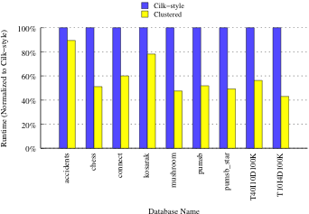
Frequent pattern mining runtime
Notes:
1. Due to its efficiency, robustness and guaranteed main memory footprint, the Apriori algorithm is widely used in FPM implementations including those in commercial products such as IBM’s InfoSphere Ware- house [30].

Slide 20
Iterative sparse solvers
Krylov-subspace methods such as CG, GMRES
Efficient parallelization requires
SPMD for unpreconditioned iterative sparse solvers
Task parallelism for preconditioners
E.g., incomplete factorization methods
Current solutions do not support SPMD model
PFunc supports SPMD through task groups
Barrier operation, group cancellation
Point-to-point operations coming soon!

Slide 21
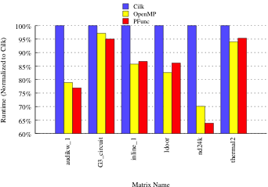
Conjugate gradient
Notes:
1. For this experiment, OpenMP was supposed to be the best. Mention that OpenMP can currently handle sparse CG because we are using their ‘’threads’’ concept to execute sparse iterations and their tasking functionality to solve the triangular solve.

Slide 22
Conclusions
PFunc increases tasking support for:
Modern HPC applications
DAG execution, frequent pattern mining, sparse CG
SPMD-style programming
Modern computer architectures
Future work
Parallelize more applications
Incorporate support for GPGPUs
https://projects.coin-or.org/PFunc

